Slide 1
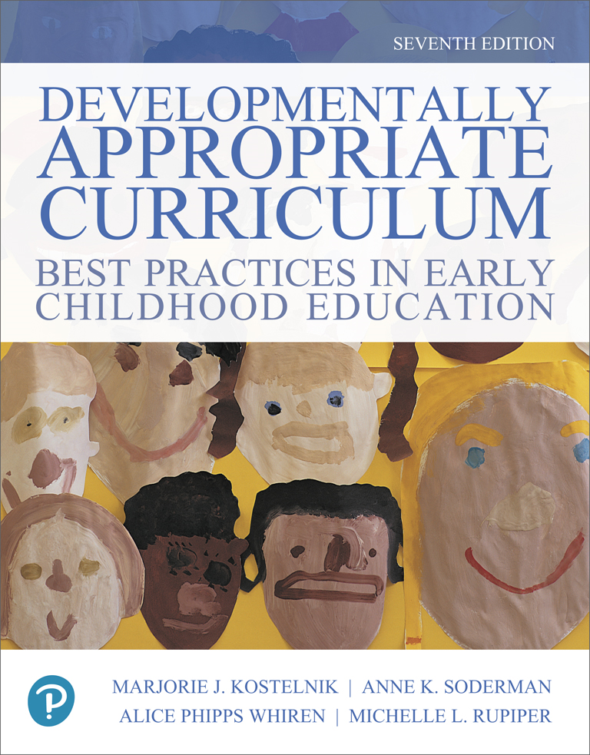
Developmentally Appropriate Curriculum: Best Practices in Early Childhood Education
Seventh Edition
Chapter 9
The Aesthetic Domain
Copyright © 2019, 2015, 2011 Pearson Education, Inc. All Rights Reserved
Notes:
If this PowerPoint presentation contains mathematical equations, you may need to check that your computer has the following installed:
1) MathType Plugin
2) Math Player (free versions available)
3) NVDA Reader (free versions available)

Slide 2
Learning Objectives
9.1 Discuss key principles of aesthetic education and how you will use this knowledge to create appropriate aesthetic experiences for young children.
9.2 Describe the developmental milestones in aesthetic preferences, musical interests, vocal music, instrumental music, creative movement, visual representations, and drama.
9.3 Plan and implement developmentally appropriate curriculum and instruction in the aesthetic domain.

Slide 3
What is Aesthetics?
Aesthetics is:
The ability to be sensitive to beauty in nature and in the arts
The ability to recognize and appreciate the arts

Slide 4
What are the Arts?
The arts are both the process and the results of creative work.
Four broad categories of arts are:
Visual arts
Performing arts
Usable arts
Literary arts

Slide 5
Aesthetic Development
Responsive—learning about art and nature by responding to it
Productive—learning about the arts by creating art

Slide 6
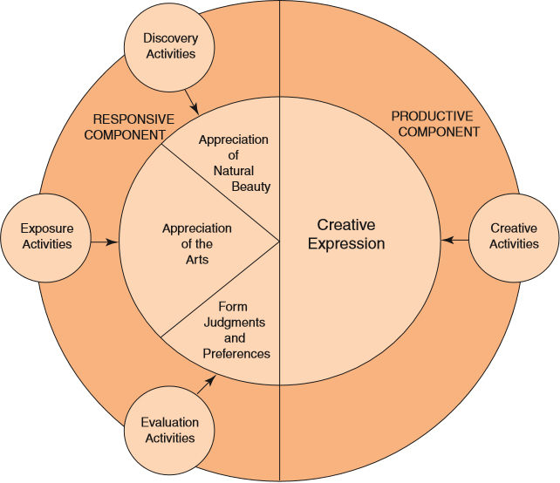
Name Some Activities That Fit Each Part of the Model

Slide 7
Visual Art Examples
Drawing
Painting
Sculpture
Collage
Printmaking
Photography
Many others

Slide 8
Performing Art Examples
Singing
Dancing
Playing instruments
Drama
Storytelling
Movie, T V, and radio production
Many others

Slide 9
Usable Art Examples
Pottery
Jewelry
Knitting
Weaving
Basketry
Clothing design
Many more

Slide 10
Literary Arts Involve Writing and Composing
Stories
Poetry
Jokes and skits
Plays and screenplays
Descriptions and essays
Memoirs and novels
Magazine and newspaper articles

Slide 11
Importance of Aesthetic Learning (1 of 2)
Focuses on connections to nature
Teaches value of the arts in our world
Provides personal fulfillment
Instills good work habits
Provides successful experiences
Makes other curriculum areas meaningful

Slide 12
Importance of Aesthetic Learning (2 of 2)
Transmits cultural heritage
Establishes a bond between generations
Builds group cohesion

Slide 13
Connections to Aesthetic Learning and Knowing (1 of 2)
Physical knowledge: Demonstrates physical properties of materials
Logical–mathematical knowledge: Illustrates relationships and teaches vocabulary for describing, comparing, and evaluating
Representational knowledge: Uses symbols to mean something

Slide 14
Connections to Aesthetic Learning and Knowing (2 of 2)
Social–conventional knowledge: Teaches facts, traditions, and conventions in society
Metacognition: Teaches thinking about thinking

Slide 15
Development of Aesthetics
Preferences
Musical interest
Vocal music behavior
Instrumental music interests
Creative movement and dance behavior
Visual art expression
Dramatic behavior

Slide 16
Teacher’s Role
For aesthetic success, teachers should:
Provide high-quality creative art
Be enthusiastic about beauty in nature and the arts
Support creative dramatics
Integrate art and music in the curriculum
Encourage individual expression
Strive to become more creative

Slide 17
Talking to Children about Their Creative Projects
Effects of traditional talk:
Compliments
Judgments
Valuing statements
Questions
Probes
Correcting statements

Slide 18
Effective Responses to Children’s Art
Response | Examples | Impact on Child
Acknowledge effort. | “You worked a long time on it.” | My hard work is noticed.
Ask for information. | “Show me a part you like.” “Tell me something about your picture.” | I can tell things about my art that only I know.
Recognize progress. | “This is the third drawing you’ve made about our field trip.” | I’ve accomplished a lot.

Slide 19
Aesthetic Strategies (1 of 3)
Model your own enthusiasm
Prepare the environment
Organize an area for creative art
Collect props to support art, music, dance, and drama
Value the creative process
Teach respect for materials
Enjoy music activities daily

Slide 20
Aesthetic Strategies (2 of 3)
Motivate creative thinking
Demonstrate techniques
Use motivational talk
Role-play ideas
Collect and mount photographs of real objects, animals, or events
Encourage imagining
Use the outdoors for aesthetic awareness

Slide 21
Aesthetic Strategies (3 of 3)
Connect creative experiences to concepts
Know the material before children use it
Demonstrate new processes
Use the illustrations in picture books as examples of art
Use various kinds of questions
Because all children benefit from involvement in the arts, adapt the arts for all children

Slide 22
Pitfalls to Avoid
Don’t make a model when demonstrating techniques
Don’t hurry children into creating a product
Don’t waste children’s time
Don’t over-direct
Don’t reinforce only realistic outcomes

Slide 23
Copyright

