Slide 1
Games Teachers Play
NAECTE Summer Virtual Conference 6/14/2021
Session 2 11:45am-12:45pm CT
Meeting 5: Play in Teacher Education
Melanie Loewenstein, Ph.D
Nicole Pearce, Ph.D.
Toni Sturdivant, Ph.D.
Josh Thompson, Ph.D.
http://faculty.tamuc.edu/jthompson/Games
Notes:
Nicole

Slide 2
Learning Through Play in Teacher Education
Texas A&M University-Commerce
Curriculum & Instruction Department
Early Childhood Education Program
“Where Teachers Come To Learn!”
Regional State University
200 undergrad EC-Grade 6
F2F, Blended, Online
4 undergrad ECE Courses -
  Child Development
  Language Acquisition
  Learning Environments
  Curriculum (STEAM)
8 grad courses
  Child Development
  Literacy
  STEM
  Creative Arts
  Classroom Management
  Inquiry, Reggio-inspired
  Curriculum
  Learning Environments
Notes:
Melanie

Slide 3
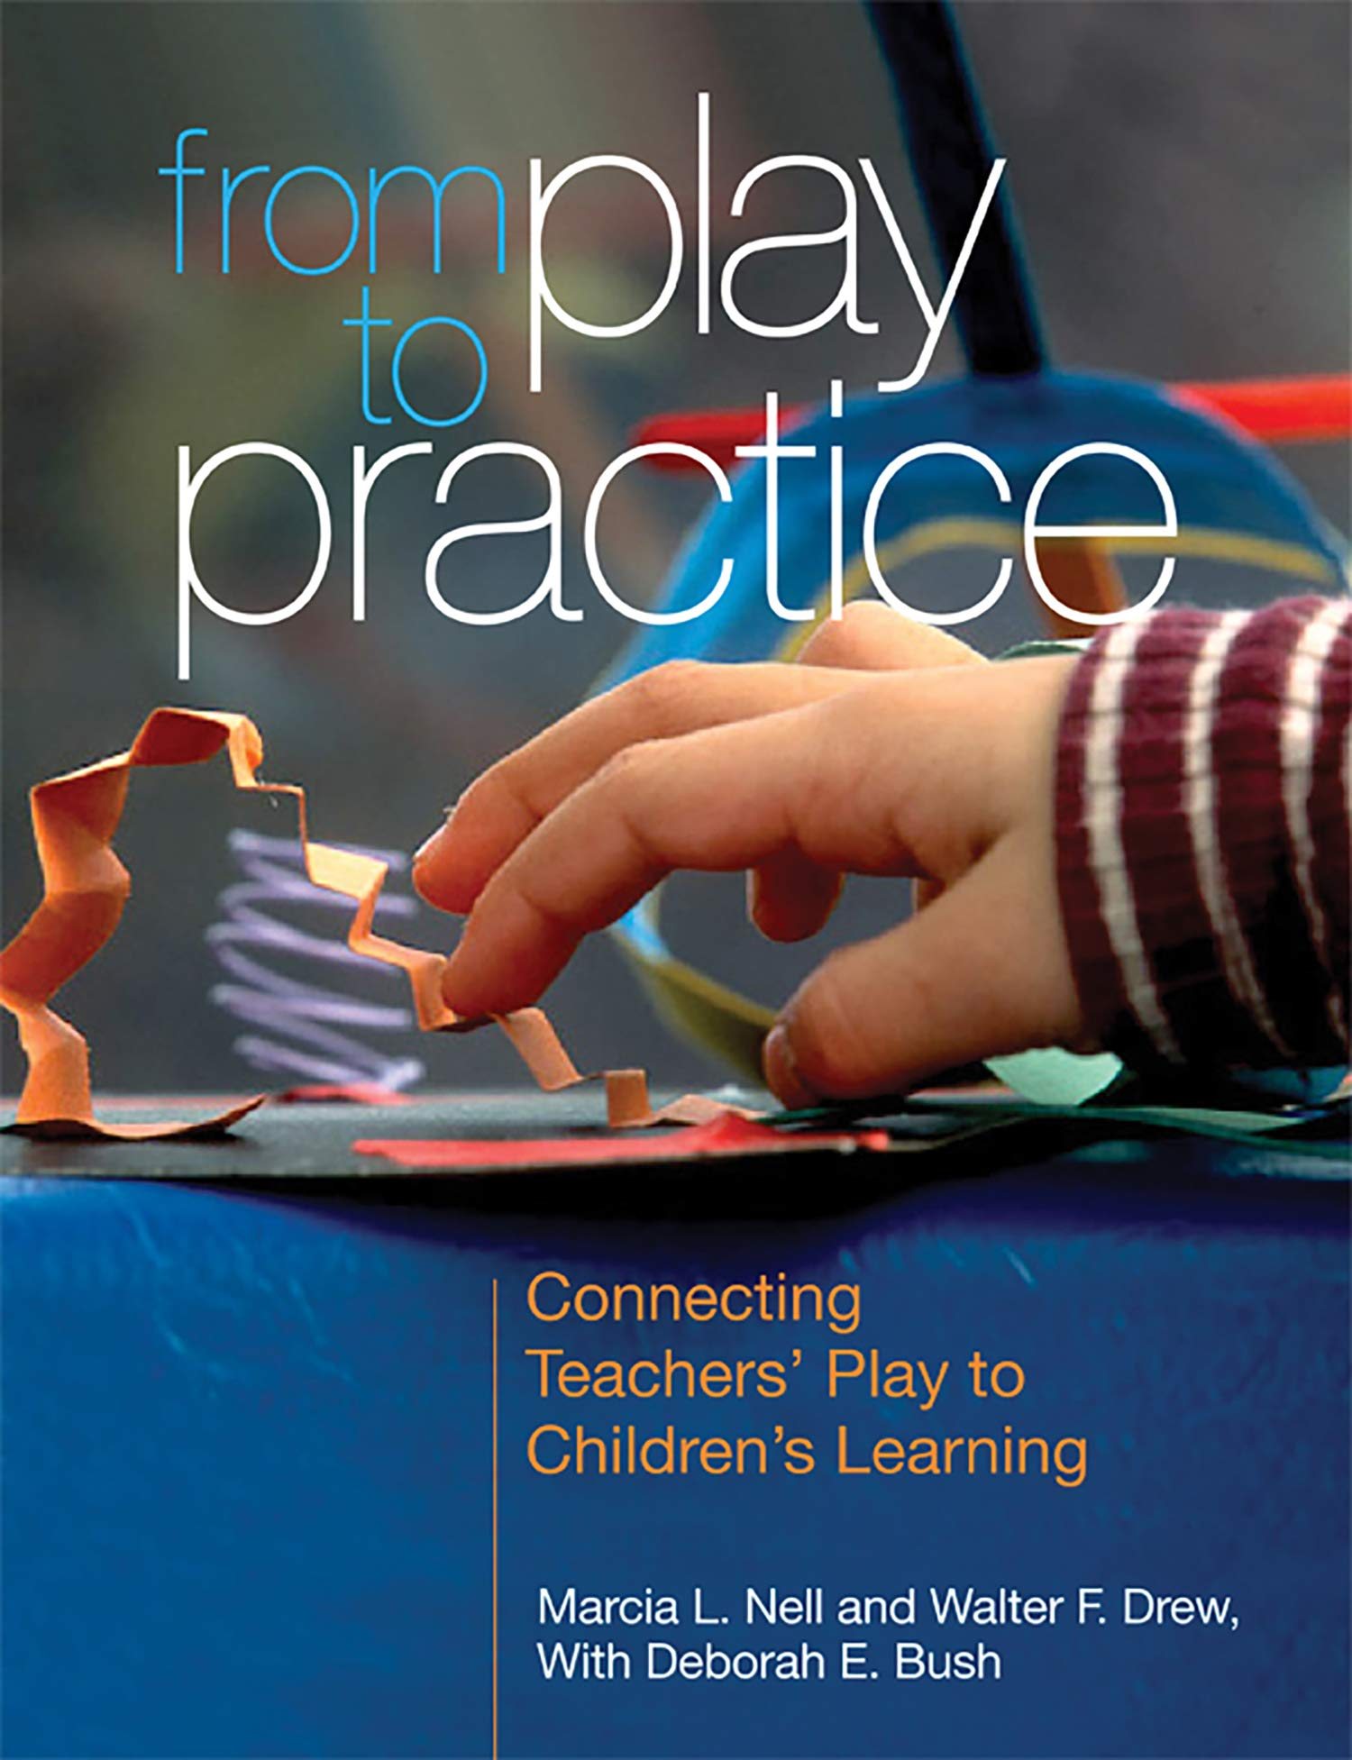
“For children, play is at the heart of early understandings about the natural world, mathematical concepts, literacy, and social and emotional competence. For adults, hands-on play and reflection lead to personal growth and foster insight into how children learn.” (Nell, Drew, Bush, 2013, p. 5)

Slide 4
Does playful learning make a difference in EC teacher preparation?
Teacher educators search for effective ways to engage their audience
Assist them with Praxis
Do successful playful experiences in adult education increase playful teaching with young children?
Notes:
Toni, why we’re doing this

Slide 5
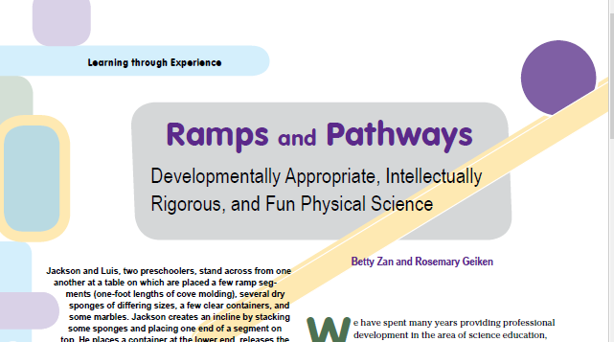
Ramps & Pathways
Makerspace
Loose parts
Open-ended exploration
Challenge, provocation, prompts
https://photos.app.goo.gl/s3mjwzH1wGEHMYoMA
Notes:
Josh

Slide 6
Play is Equity
Playful learning brings equity to early learning, and to teacher preparation. The best way to ‘level the playing field’ is to promote, permit, and expect playful learning.
See NAEYC (2019) Addressing Equity, and NAEYC (2020) DAP
“Integrating play within our courses prepares future educators to serve economically, culturally, and linguistically diverse students more effectively, presenting students with more equitable learning opportunities. Future educators learn the significance of providing diverse student populations with rich and authentic experiences inherent in play” (Loewenstein, Sturdivant, & Thompson, in review).

Slide 7

Oral Language Development Experiences
Storytelling
  “Story Acting” With Preservice Teachers
Phonological Awareness
  Draw-A-Rhyme Story Experience
Notes:
Melanie

Slide 8
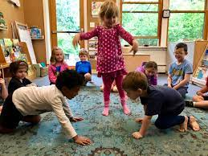
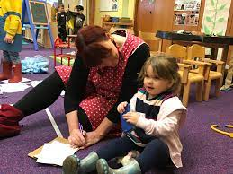
Vivian Paley Story Acting
Original Story Telling:
Child dictates a story to the teacher.
Small group of children act out the child’s story. As rehearsed and practiced with the teacher. The teacher narrates the dictated story during the reenactment.
Retelling A Scene From An Author’s Story (Adjusted):
Children act out a scene from a story that was read to the class. The teacher reads the portion of the story during during the reenactment.
Notes:
Melanie

Slide 9

Story Acting (Vivian Paley) With Pre-Service Teachers
Oral Story 3:
A girl lost her pretty red umbrella. The rain fell on her and she ran in the house really fast.
Oral Story 4:
The baby wouldn’t stop crying so a dinosaur tried to make him happy. The baby kept crying.
In small groups, pre-service teachers reenact one of the stories, while one of the group members narrates the story to the class.
Oral Story 1:
A boy saw a cricket taking a bath. He told the silly green cricket to go away.
Oral Story 2:
A furry green cat three a bull and then the monkeys tried to catch the ball.
Notes:
Melanie

Slide 10


“Let’s Play!”
Playful Drawing
Get a piece of paper and a writing instrument of your choice.
Draw-A-Rhyme Story
When you draw a monster, it is said, you always begin with his ______.
He’ll be able to see when he flies, if we draw two bright _____.
To tell which way the cold wind blows, our monster will need a great big _____.
Look to the north and look to the south, now we can give our monster a _____.
Notes:
Melanie

Slide 11
Draw-a-Rhyme Story
Some up above and some beneath, our monster has lots of _____
Now under his chin, lets just check, that’s where we should put his _____.
So he won’t be tipsy-toddy, let’s give him a polka-dot ____.
If he really, really begs, I guess we could give him _____.
Notes:
Melanie

Slide 12
Draw-a-Rhyme Story
To make our monster nice and neat, we’ll have to teach him to wipe his ____.
A notice sent by air mail! We can’t forget the monster’s ______.
He isn’t fierce, he isn’t hairy, but don't you think he’s a little _____.
Show your playful masterpieces!!
Notes:
Melanie

Slide 13
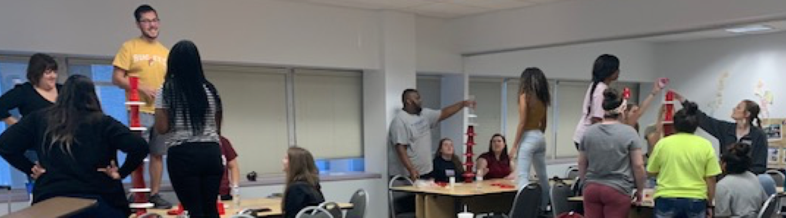
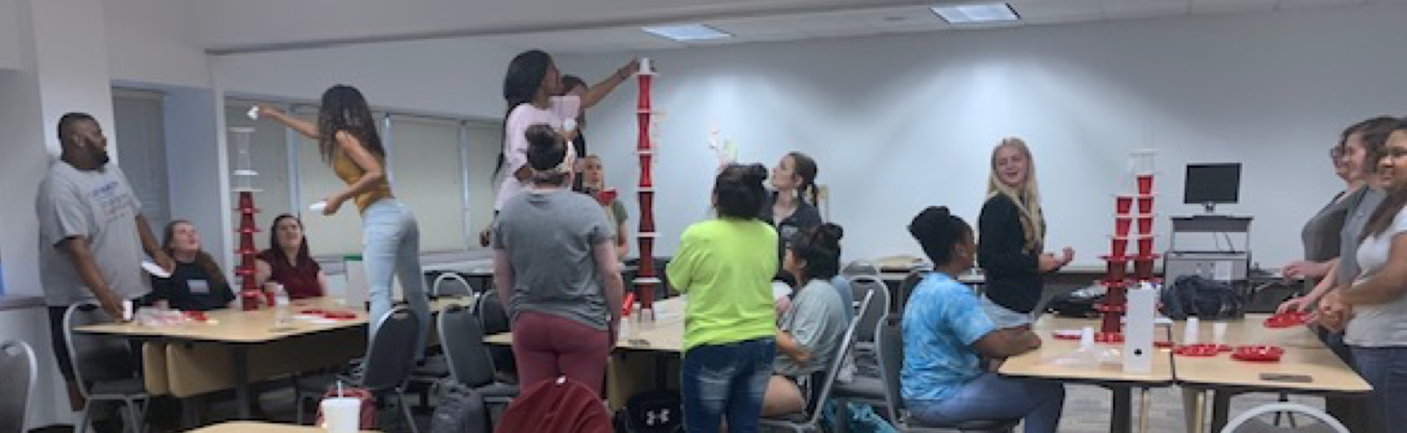
Design Challenge: Understanding Group Dynamics through Play
Link to “Group Dynamics” slide deck
Notes:
Nicole

Slide 14
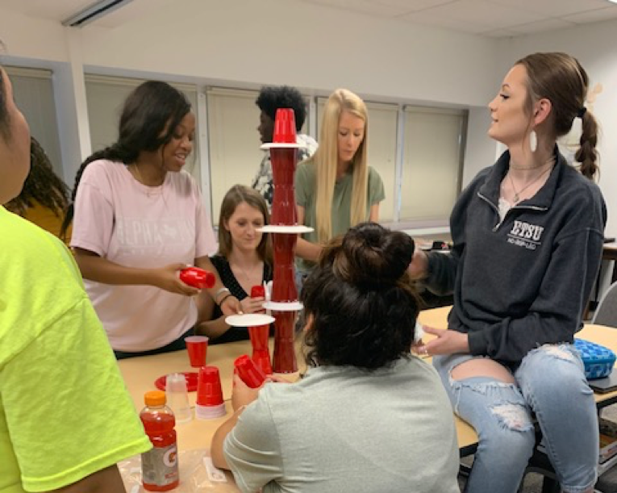
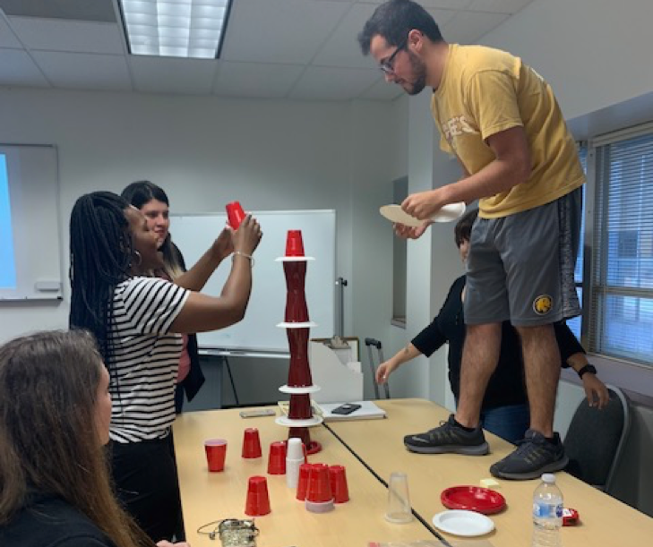
“The secret sauce is playfulness” — the ability to see a situation and be curious about it, realize it can be enjoyable, and take agency over it. “It’s like ‘A Spoonful of Sugar’ in Mary Poppins. Even cleaning up can be fun, if you have the right mindset.”
Ben Mardell-Project Zero.
Notes:
Nicole

Slide 15
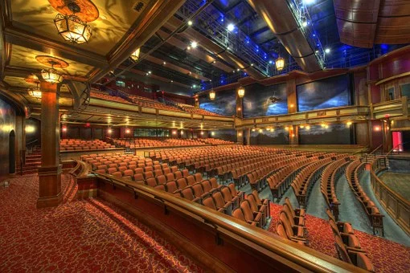
Theorist Theater
Vignette 5: In a child development theories course, students pretended to be theorists and their peers guessed who they were. The names of theorists covered in the reading for the week were placed in a bowl. Volunteers came to the front of the class, picked a name, and acted out their interpretation of a theorist.
Notes:
Toni

Slide 16
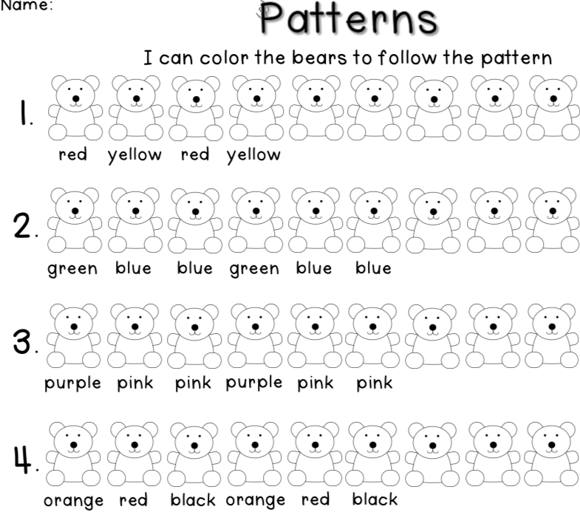
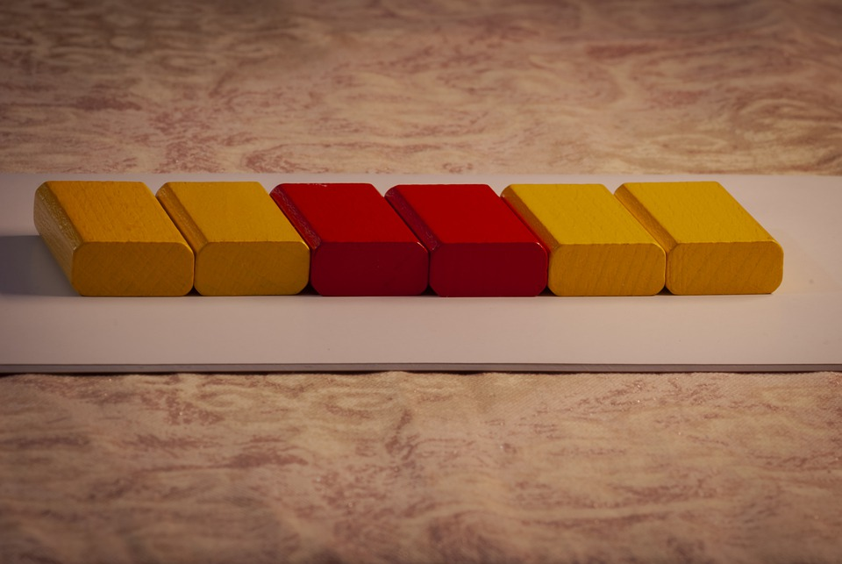
Changes in Student Lessons
Notes:
Toni, how did our students change their behaviors

Slide 17

Games Teachers Play
Questions? Reflections?
Melanie Loewenstein, Ph.D
Nicole Pearce, Ph.D.
Toni Sturdivant, Ph.D.
Josh Thompson, Ph.D.
Texas A&M University-Commerce
http://faculty.tamuc.edu/jthompson/Games
Notes:
Toni

