Slide 1
THE TEXAS A&M UNIVERSITY SYSTEM 2021 Chancellor's Summit on Diversity, Equity, and Inclusion
Forum: Addressing Issues of Social Justice in Higher Education
Marta A. Mercado-Sierra, Ph.D. Assistant Professor Department of Social Work College of Education and Human Services | Josh Thompson, Ph.D. Associate Professor Department of Curriculum and Instruction College of Education and Human Services
Background music by Nina Simone

Slide 2
Diversity, Equity, Inclusion & Social Justice

Slide 3
Higher Education & Social Justice
Institutional purpose:
Ensure students reach their full potential
Pathway to economic opportunities and social mobility
Social Responsibility
Principles of Social Justice in Higher Ed. (Fraser, 2005; Freire 1992, 2000)
Recognition
Distribution
Representation
Freedom

Slide 4
DIVERSITY
Cultural Dimension
Recognition
EQUITY
Economic Dimension
Distribution (resources/power)
Opportunities
INCLUSION
Political Dimension
Representation
Participation
Fraser (2005)

Slide 5
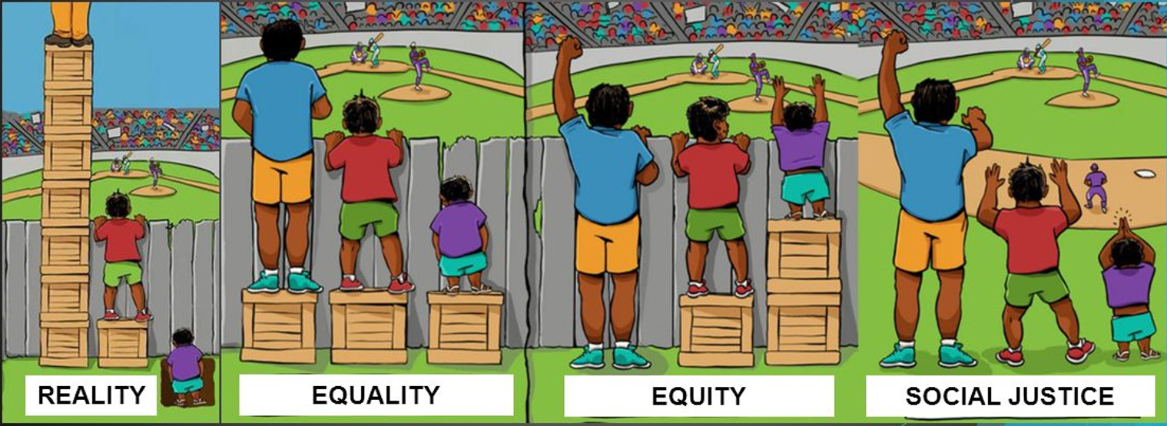
Relationship between Diversity, Equity, Inclusion & Social Justice

Slide 6
Cultural Diversity
Age
Sex
Race
Ethnicity
Nationality
Language and Accents
Traditions/Customs
Citizenship
Cognitive Abilities
Physical Abilities
Socioeconomic Status (Education, Income & Occupation)
First-generation College Students
Sexual Orientation
Gender Identity
Gender Expression
Marital Status/Parental Status
Military Status
Religious & Spiritual Beliefs
Political Beliefs
Ideologies, Worldviews
Criminal Background
Mental Health
…

Slide 7
Do We Tolerate or Embrace Diversity?
Tolerance
Acceptance
Grudging resignation
Tension
Detract from
Entrapment
Fate cannot be changed
Learning for Justice
www.learningforjustice.org
Open willingness
Softening
Lean into
Freedom
Fate is created

Slide 8
Oppression & Microaggressions

Slide 10
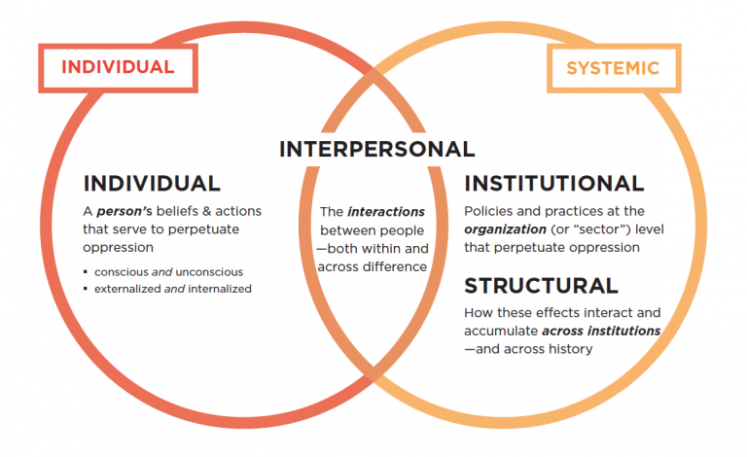
How Do We Sustain Systemic Oppression?

Slide 11
Microaggressions Contemporary forms of implicit or explicit biases expressed or presented subtly and briefly communicating hostile, derogatory, or harmful smears on a daily basis to an individual or group based on their social status (Sue et al. (2010).
Micro-insults:
Micro-invalidations (verbal or environmental/symbolic):
Names of building, programs,
Signs (Disabled bathrooms on the second floor)
Representation or non-representation of people in webpage, flyers, etc.
Exclusion of some categories of identity in forms, surveys
“America is a melting pot”
“There is only one race, the human race”
“I don’t see color”
Why don’t you speak Spanish if you are Latinx?
“You have a strong accent, but your vocabulary is impressive”.
“That food looks/smells disgusting”.
“You are so beautiful for an African American”.

Slide 12
Share an incident of microaggression (attitudes, behaviors, practices) you have experienced.
How have you engaged in acts of microaggressions as a peer, a student, staff, faculty, supervisor, administrator?
Background music by Francisco Treviño

Slide 13
Privilege

Slide 14
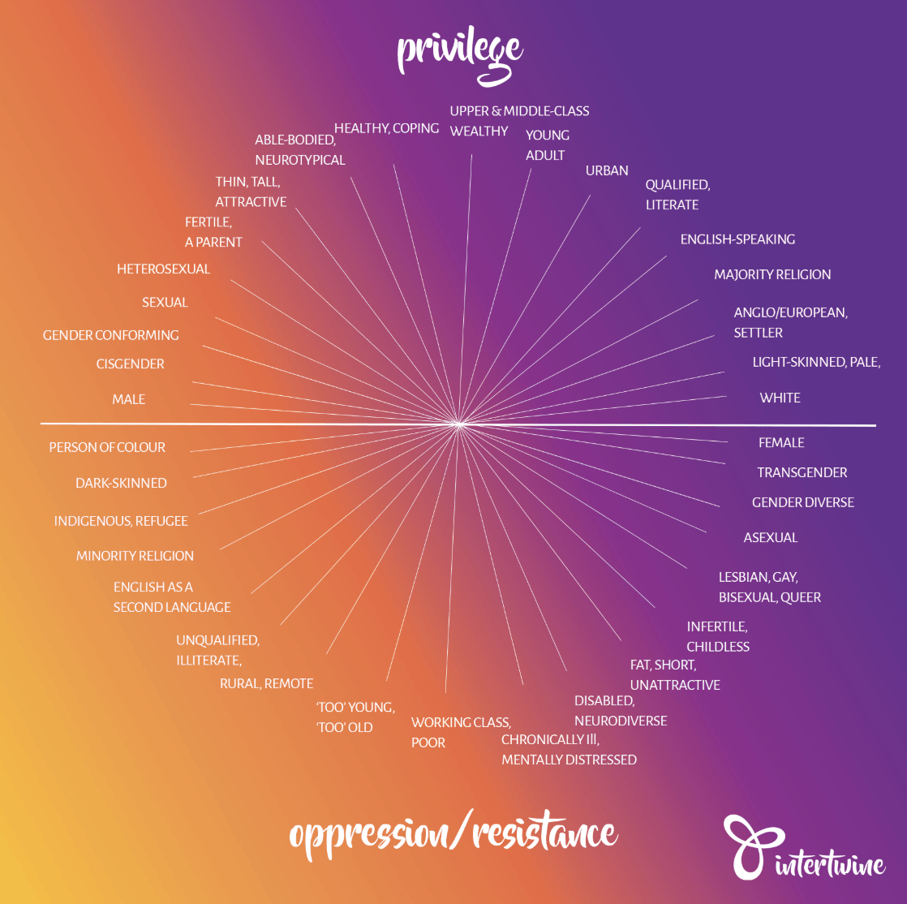

Slide 15
How will you use your privilege to contribute to a more just campus life?
Background music Peruvian flute

Slide 16
Social Justice in Higher Education

Slide 17
Social Justice as a Process of the Present
Individual Agency
Promoting and valuing diversity & engage in acts of inclusion and equity
Individual Agency (Faculty, Staff, Students)
Political Will
Top Institutional Management
Embrace diversity
Equal opportunities
Redistribution of resources and power
Representation
Participation
Organizational Culture
Social Responsibility with Social Justice
Social, Economic and Political Success

Slide 18
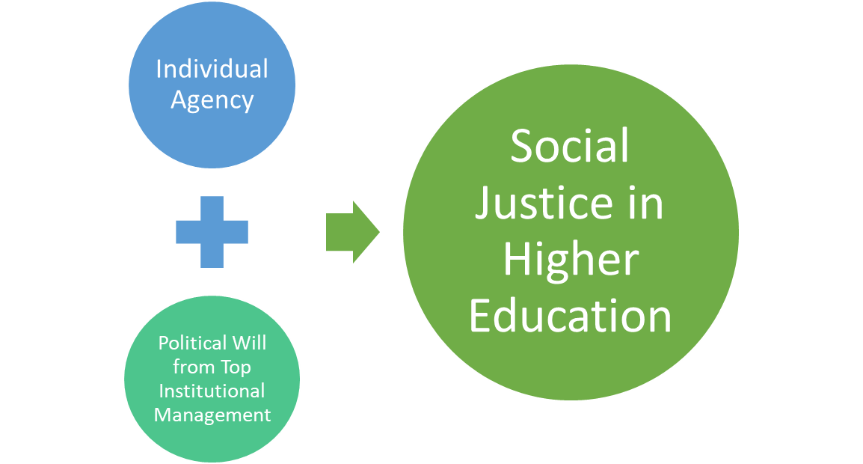
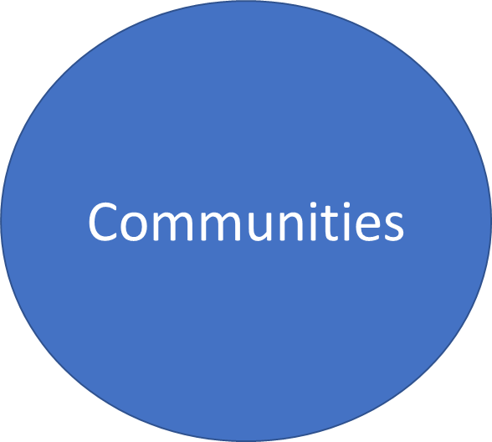
Social Justice in Higher Education

Slide 19
Social Justice The Last Building Block
Social Justice
Inclusion
Equity
Diversity
How?
Affirmative strategies
Transformative strategies
Culturally Grounded Approach
Intersectionality Perspective
Human Rights
Anti-colonial
Anti-oppressive

Slide 20
As a student, staff, faculty, manager, supervisor, head of department, dean, administrator, visualize what justice in practice in higher education looks like. What does justice in higher education look like or should look like to you?
Background music Chad Lawson

Slide 21
Wrap-up
Awareness -
Oppression & Privilege
Self-reflection - Challenging Perspectives
and Embracing Social Justice
in our Worldview
Action
Towards Cultural Diversity, Equity, & Inclusion
Social Justice
Respect, Access, Participation, Representation
Notes:
This 2-day workshop aims to facilitate an experiential gathering to recognize our biases and reflect on our unconscious bias to initiate our path from tolerance to embracing diversity, equity and promote inclusive environments in our personal and professional lives with our verbal, non-verbal, and symbolic interactions.

Slide 22
References
Resource page: http://faculty.tamuc.edu/jthompson/SocialJustice

Slide 23
Thank you! ¡Gracias!
Forum: Addressing Issues of Social Justice in Higher Education
Marta A. Mercado-Sierra, Ph.D. Marta.Mercado-Sierra@tamuc.edu | Josh Thompson, Ph.D. http://faculty.tamuc.edu/jthompson/SocialJustice
Background music by Nina Simone

