Slide 1
Cascading Waves and Cycles of Development
Zlata Stanković-Ramirez, Ph.D.
Josh Thompson, Ph.D.
Drawn from NAEYC (2022) & Co-LAB, a collaboration of international scholars

Slide 2
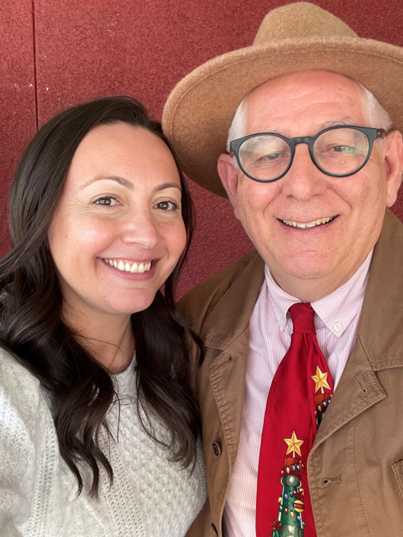
Drs. Z and JT
Zlata Stanković-Ramirez, Ph.D.
Assistant Professor of Instruction in Psychology
The University of Texas at Dallas
School of Behavioral & Brain Sciences
Richardson, Texas
zlata.stankovic-ramirez@utdallas.edu
Josh Thompson, Ph.D.
Professor Early Childhood Education
Texas A&M University-Commerce
Commerce, Texas
josh.thompson@tamuc.edu

Slide 3


Agenda
A
In today’s session, we will explore:
Innovative Way to Look at the Child Development
Image of the child shapes teacher behavior
Planes, Ages and Stages (Theorists)
Developmental Cascades, Waves and Cycles

Slide 4

B

Slide 5
Co-LAB
C
A collaboration of scholars, international, multi-disciplinary, exploring insights from Developmental Psychology and bringing them into
Early Childhood Care and Education.
faculty.tamuc.edu/jthompson/co-lab

Slide 6
Our study of DAP
D
Stanković-Ramirez, Z. & Thompson, J. (2018). Rethinking developmental domains to improve classroom observations. Texas Child Care Quarterly, 42(2), 20-27.
Thompson, J., & Stanković-Ramirez. (2021). What early childhood educators know about developmentally appropriate practice. Phi Delta Kappan, 103(2), pp. 20-23.
Stanković-Ramirez, Z., & Thompson, J. (2022). A new view of Developmentally Appropriate Practice: What early childhood educators know about waves, individuals, and equity. TEPSA Leader: Texas Elementary Principals and Supervisors Association 35(2), 1-7.

Slide 7
Developmentally Appropriate Practice
“results from the process of professionals making decisions about the well-being and education of children based on at least three important kinds of information or knowledge
(NAEYC, 2020)

Slide 8
Developmentally Appropriate Practice (4th edition)
The National Association for the Education of Young Children (NAEYC) composed Developmentally Appropriate Practice (DAP) in 1987 and continues to revise and improve DAP aimed at helping early childhood educators. (3+9)
Q1: In what ways are you implementing DAP, or not yet?

Slide 9
DAP: 3 Core Considerations

Slide 10
DAP: I. Development and Learning
First, what is known about child development and learning — knowledge of age-related human characteristics that permits general predictions within an age range about what activities, materials, interactions, or experiences will be safe, healthy, interesting, achievable, and also challenging to children;

Slide 11
DAP: II. The individual child
Next, what is known about the strengths, interests, and needs of each individual child in the group – to be able to adapt for and be responsive to inevitable individual variation;

Slide 12
DAP: III. Social and Cultural Context
Finally, knowledge of the social and cultural contexts in which children live – to ensure that learning experiences are meaningful, relevant, and respectful for the participating children and their families.

Slide 13
DAP: 9 Principles

Slide 14
DAP: 1. Nature AND Nurture
Development and learning are dynamic processes that reflect the complex interplay between a child’s biological characteristics and the environment, each shaping the other as well as future patterns of growth.

Slide 15
DAP: 2. Domains
All domains of child development—physical, aesthetic, cognitive, social, emotional, and linguistic development (including bilingual or multilingual development), as well as approaches to learning—are important; each domain both supports and is supported by the others.

Slide 16
DAP: 3. Play
Play promotes joyful learning that fosters self-regulation, language, cognitive and social competencies as well as content knowledge across disciplines. Play is essential for all children, birth through age 8.

Slide 17
DAP: 4. Variations
Although general progressions of development and learning can be identified, variations due to cultural contexts, experiences, and individual differences must also be considered.

Slide 18
DAP: 5. Constructive Learning
Children are active learners from birth, constantly taking in and organizing information to create meaning through their relationships, their interactions with their environment, and their overall experiences.

Slide 19
DAP: 6. Motivation
Children’s motivation to learn is increased when their learning environment fosters their sense of belonging, purpose, and agency. Curricula and teaching methods build on each child’s assets by connecting their experiences in the school or learning environment to their home and community settings.

Slide 20
DAP: 7. Integrated
Children learn in an integrated fashion that cuts across academic disciplines or subject areas. Because the foundations of subject area knowledge are established in early childhood, educators need subject-area knowledge, an understanding of the learning progressions within each subject area, and pedagogical knowledge about teaching each subject area’s content effectively.

Slide 21
DAP: 8. ZPD
Development and learning advance when children are challenged to achieve at a level just beyond their current mastery and when they have many opportunities to reflect on and practice newly acquired skills.

Slide 22
DAP: 9. Tech
Used responsibly and intentionally, technology and interactive media can be valuable tools for supporting children’s development and learning.
(NAEYC, 2020)
Q2: How does your use of technology enhance children’s development and well-being?

Slide 23

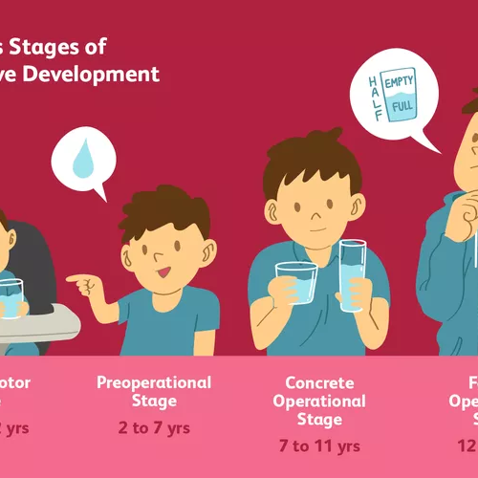
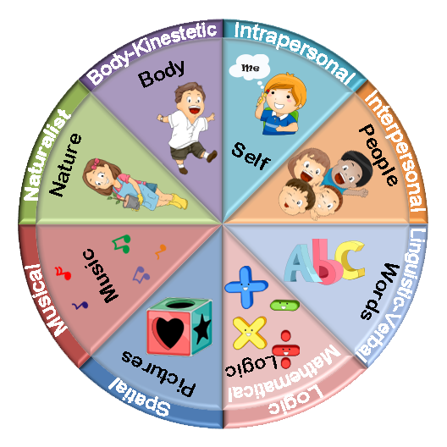
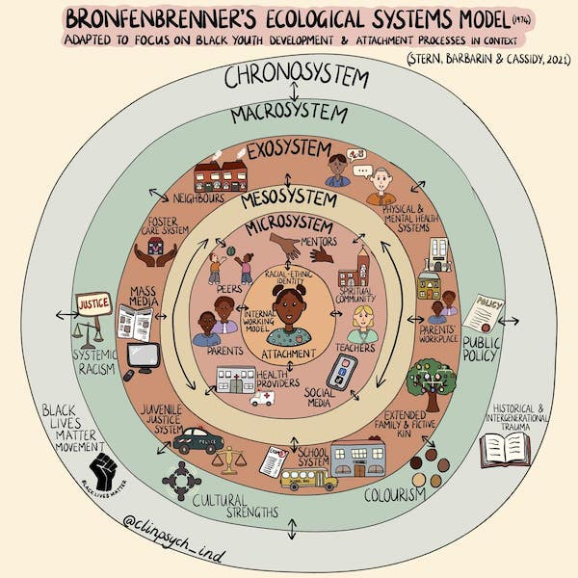
Theories of Development
Planes, Ages and Stages
Developmental Cascades
Waves and Cycles
Planes of Development
Ages and Stages
Multiple Intelligences
Ecological Systems
Montessori
Piaget, Vygotsky, Erikson
Gardner
Bronfenbrenner

Slide 24
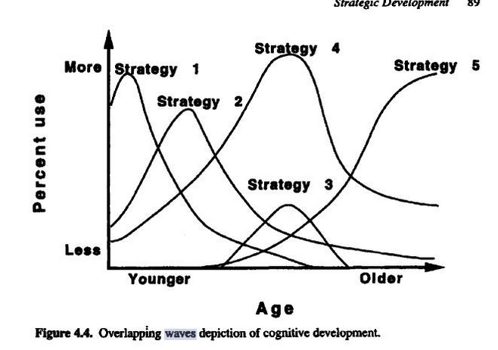
New Perspectives of the Child
Planes, Ages and Stages
Developmental Cascades
Waves and Cycles
Waves and Cycles
Developmental Cascades
Masten & Cicchetti (2010)
Oakes & Rakison (2020)
Tamis-LeMonda & Lockman (2023)
Siegler (1996)

Slide 25
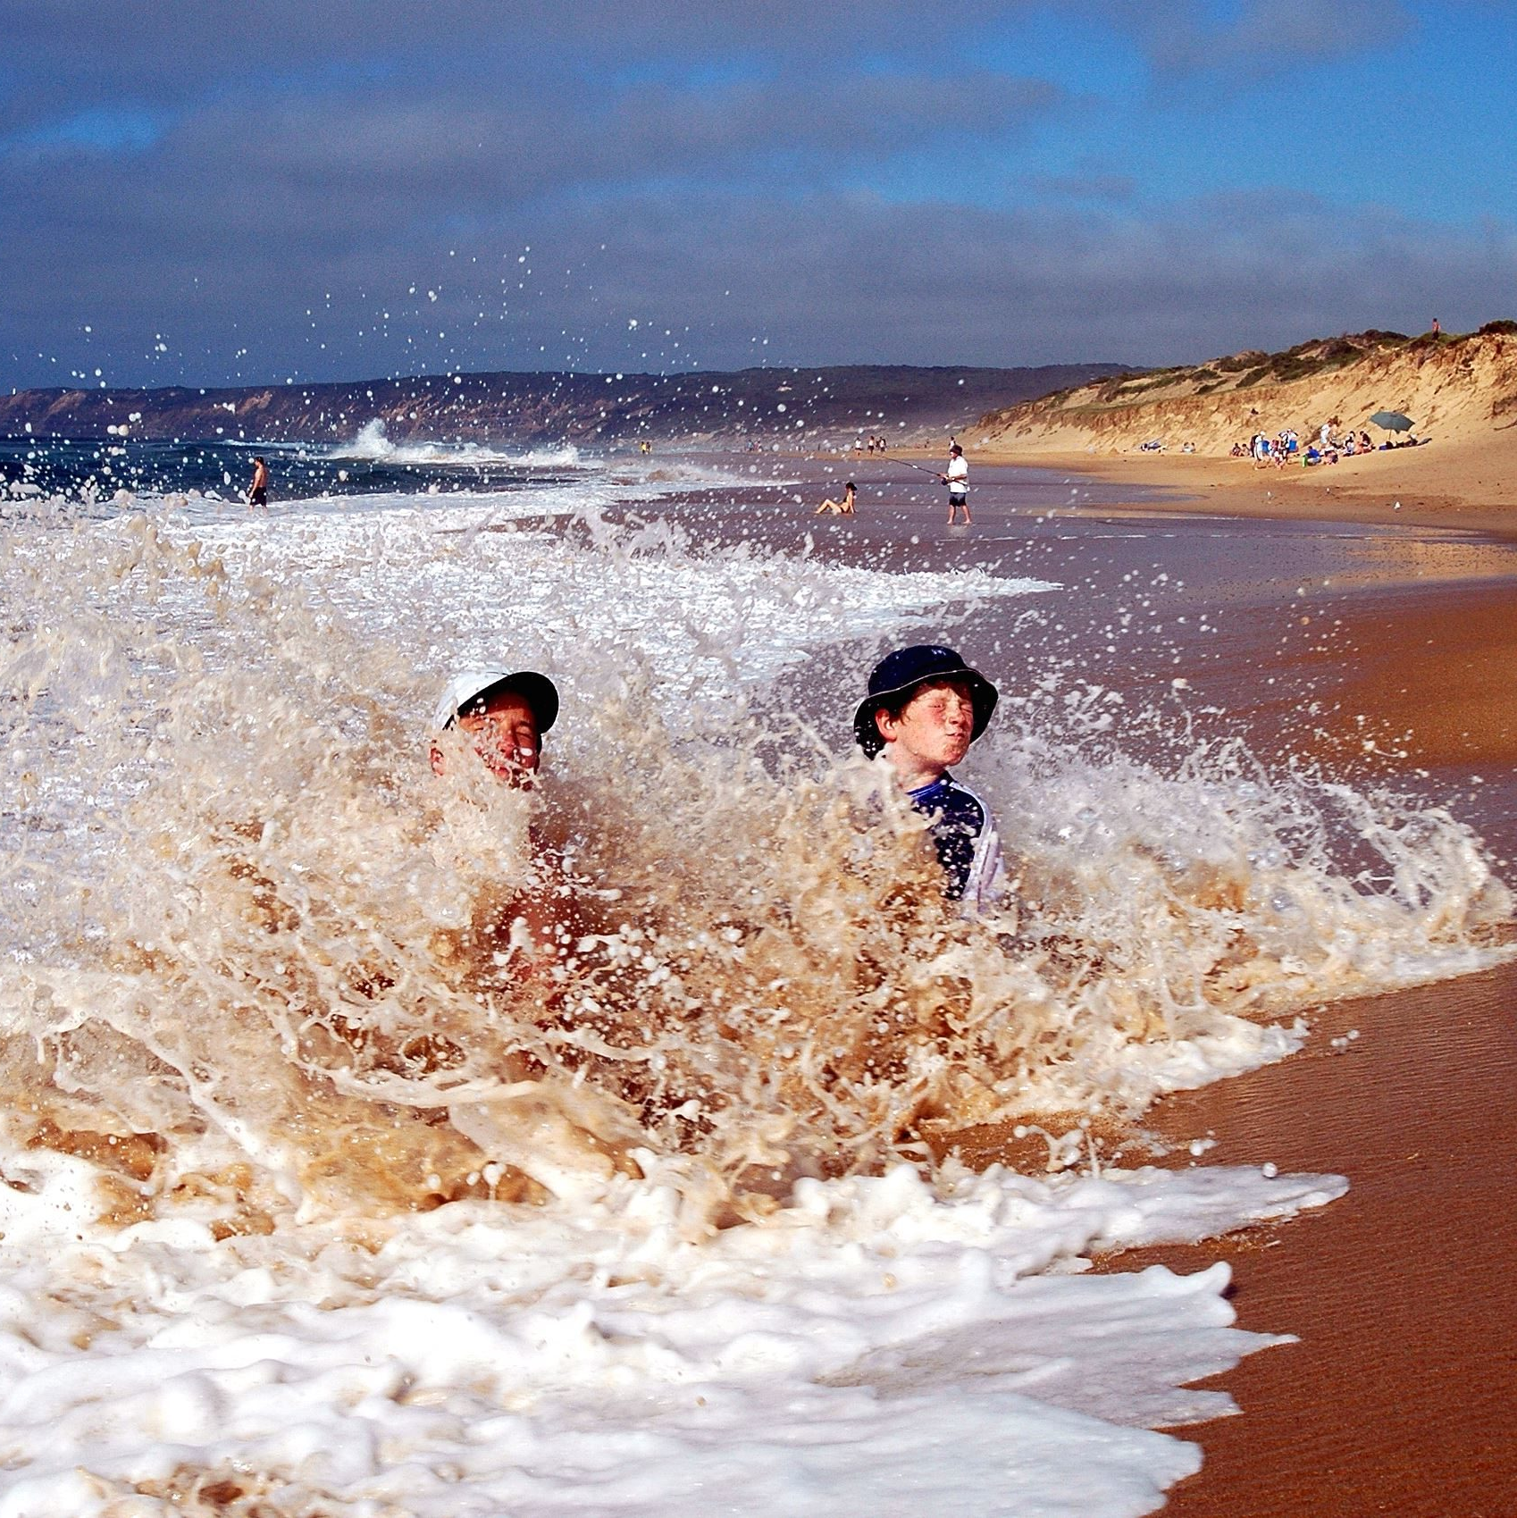
Waves & Cycles
“The waves of development, the ebb and flow of growth and processing, acquisition and reconsideration, all together map a process of typical child development, and attending to these waves empowers educators of children of all ages to go with the flow.”
Stanković-Ramirez & Thompson, 2022, 5

Slide 26

Developmental Cascades
DC
Insights from Developmental Psychology
Society for Research in Child Development SRCD
Oakes & Rakison (2020)
Tamis-LeMonda and Lockman (2023)
umbrella image from Winnie the Pooh by A. A. Milne

Slide 27

Developmental Cascades
DC
NATURE:
  Abide by existing forces, like gravity
  Montessori – internal drive to auto-education
NURTURE:
  Interaction, Relationships, Caregiving
  Duncan, Stanković-Ramirez – influence of environment

Slide 28
Summary
In this session, we explored:
Developmentally Appropriate Practice (3+9)
Planes, Ages and Stages (Theorists)
Developmental Cascades, Waves and Cycles
Q3: Is the idea of ages & stages antiquated? How can we use this new model of Developmental Cascades, Waves, and Cycles as a more appropriate description of the phenomenon of child development?

Slide 29
Resources
Our articles are available here: http://faculty.tamuc.edu/jthompson/dap
Take our Survey: “What EC teachers know about DAP” (under the DAP LAB tab)
Other resources available under the Co-LAB tab:
  Masten & Cicchetti (2010)
  Oakes & Rakison (2020)
  Tamis-LeMonda & Lockman (2023)
Co-LAB: PEEQ, Texas AEYC, NAECTE, NAEYC, World Forum, Texas Rising Star, SRCD
Q4: How can you grow, change, nurture and cultivate, your view of the young child?

Slide 30
Thank you
Zlata Stanković-Ramirez, Ph.D.
Josh Thompson, Ph.D.
http://faculty.tamuc.edu/jthompson/dap

