Slide 1
Nine Principles of Montessori Education
Angeline Lillard (2016)
Montessori: The Science behind the Genius (3rd ed.)
Oxford University Press

Slide 2
Maria Montessori (1870-1952)
A drawing of
Dr. Maria Montessori by Allison Geneser

Slide 3
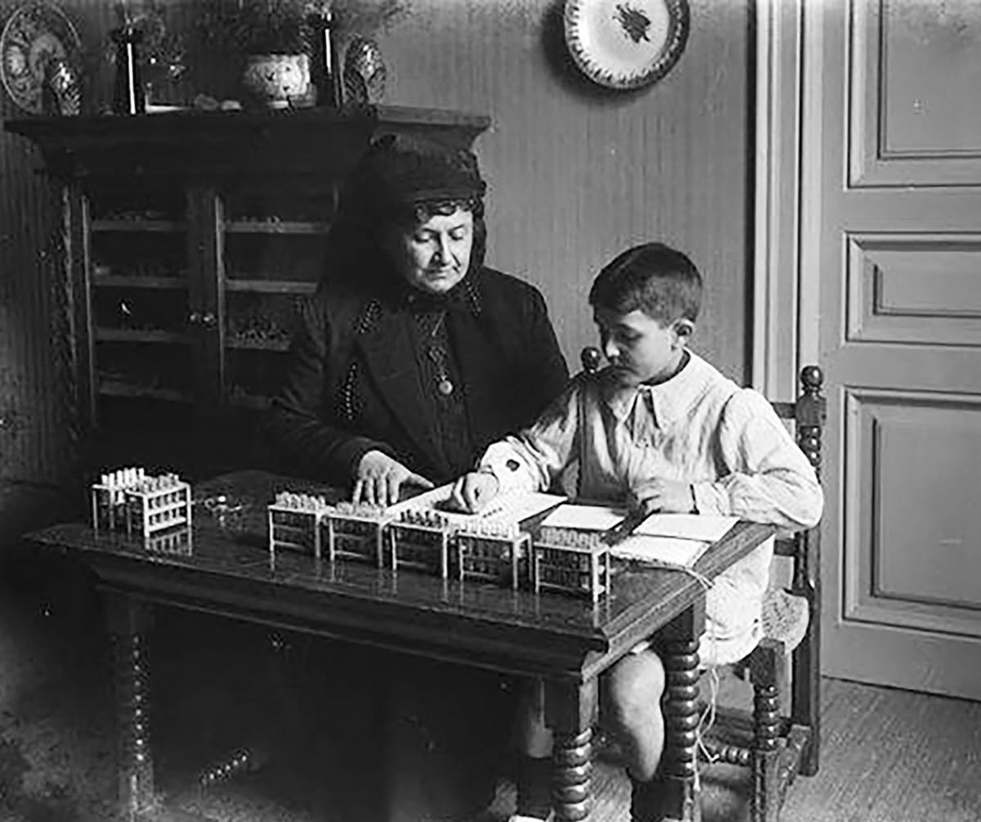
Montessori influence on education
Montessori introduced child-size furniture, now common in most early childhood education environments.
What other innovations did Montessori bring to modern education?
Maria Montessori and a child
sitting at a table, manipulating
mathematical materials.
https://montessori150.org/maria-montessori/montessori-photos

Slide 4
Montessori: Science Behind the Genius
Dr. Angeline Lillard, a psychologist from the University of Virginia, has been studying Montessori education for decades
https://www.montessori-science.org/
In this book, Dr. Lillard outlines nine principles of Montessori education that are universal, worthy of consideration in every learning environment.
Lillard, A. (2016) Montessori: The Science behind the Genius (3rd ed.) Oxford University Press.

Slide 5
Nine principles of Montessori Education
Movement & Cognition
Choice
Executive Function
Interest
Extrinsic rewards ≠ motivation
Learning from & with peers
Meaningful contexts
Teacher ways & child ways
Order in environment & mind

Slide 6
Nine principles of Montessori Education
(1) that movement and cognition are closely entwined, and movement can enhance thinking and learning

Slide 7
Nine principles of Montessori Education
(2) that learning and well-being are improved when people have a sense of control over their lives

Slide 8
Nine principles of Montessori Education
(3) executive function arises from concentrated attention

Slide 9
Nine principles of Montessori Education
(4) that people learn better when they are interested in what they are learning

Slide 10
Nine principles of Montessori Education
(5) that tying extrinsic rewards to an activity, like money for reading or high grades for tests, negatively impacts motivation to engage in that activity when the reward is withdrawn

Slide 11
Nine principles of Montessori Education
(6) that collaborative arrangements can be very conducive to learning

Slide 12
Nine principles of Montessori Education
(7) that learning situated in meaningful contexts is often deeper and richer than learning in abstract contexts

Slide 13
Nine principles of Montessori Education
(8) that particular forms of adult interaction are associated with more optimal child outcomes

Slide 14
Nine principles of Montessori Education
(9) that order in the environment is beneficial to children.

Slide 15
Nine principles of Montessori Education
Movement & Cognition
Choice
Executive Function
Interest
Extrinsic rewards ≠ motivation
Learning from & with peers
Meaningful contexts
Teacher ways & child ways
Order in environment & mind

Slide 16
Nine Principles of Montessori Education
Angeline Lillard (2016)
Montessori: The Science behind the Genius (3rd ed.)
Oxford University Press

