Slide 1
Learning together in the company of children
Josh Thompson, Ph.D.
Associate Professor ECE
Texas A&M University-Commerce
AMS E1 DMTEP 1983
father of 4, ‘Billy’ to 10, husband of 1

Slide 2
Bring a child to mind
for the sake of this keynote, keep that child in mind

Slide 3
JAKE! (not his real name)
Something about this kid:
AGE: Just over 31 months old, 2½ yr old toddler
RELATION/CONNECTION: Grandson
STRIKING FEATURE: LANGUAGE! along with phenomenal focus and concentration, ceaseless energy, tenderest compassion
https://photos.google.com/photo/AF1QipN0uwymXPtR68JgW4QQEj2hXihzazIxshEQQby1

Slide 4
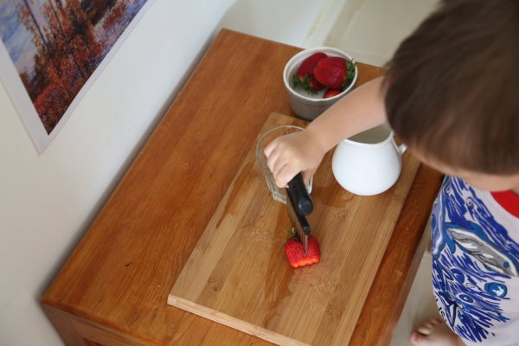
Bring a child to mind
Tell a neighbor about the child you have in mind.
Share a name (pseudonyms only, please)
Connection to you
A striking feature – why you thought of this child

Slide 5
Montessori quotes
“We permit the child to select the position which he finds most comfortable. He can make himself comfortable as well as seat himself in his own place. And this freedom is not only an external sign of liberty, but a means of education. Through such furnishing, the child has learned to command his movements.”
The Montessori Method (1912/1964)

Slide 6
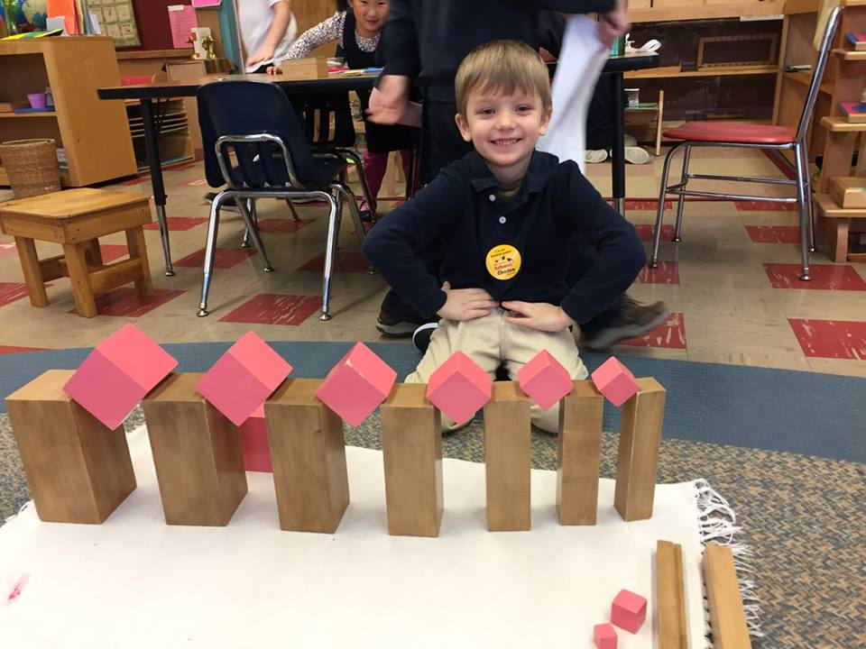
Role of the teacher
“We must help the child to act for himself, will for himself, think for himself; this is the art of those who aspire to serve the spirit.”
Education for a New World (1946)

Slide 7
Montessori ideas (and ideals)
Highly organized sets of self-help material
Spontaneous activity
Auto-education
Absorbent mind
Planes of development
Prepared environment
Three-period lesson

Slide 8
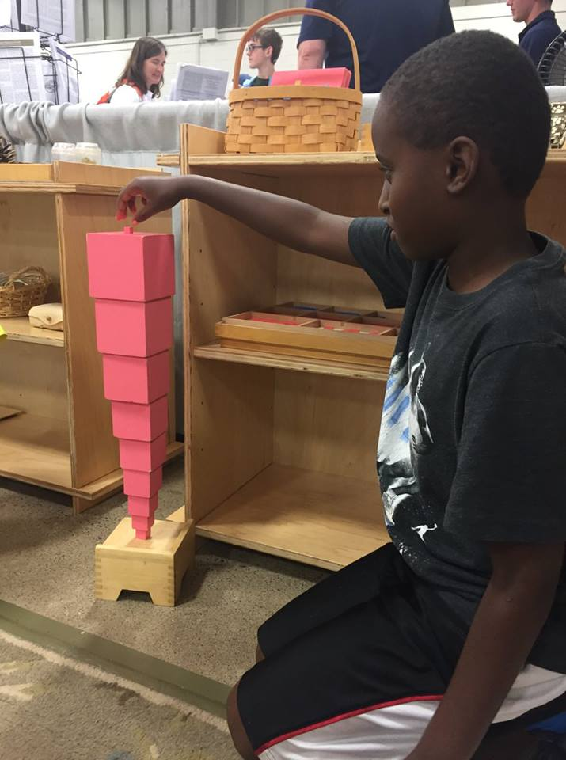
Montessori ideas (and ideals)
Highly organized sets of self-help material

Slide 9
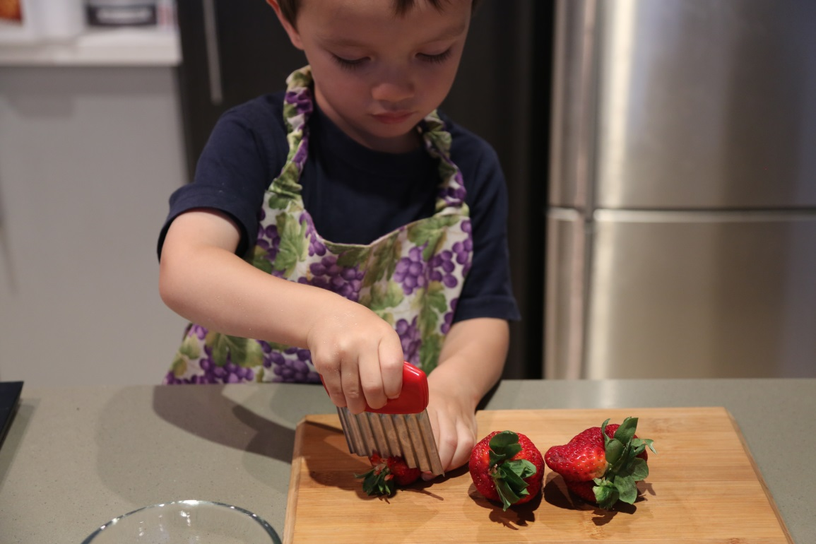
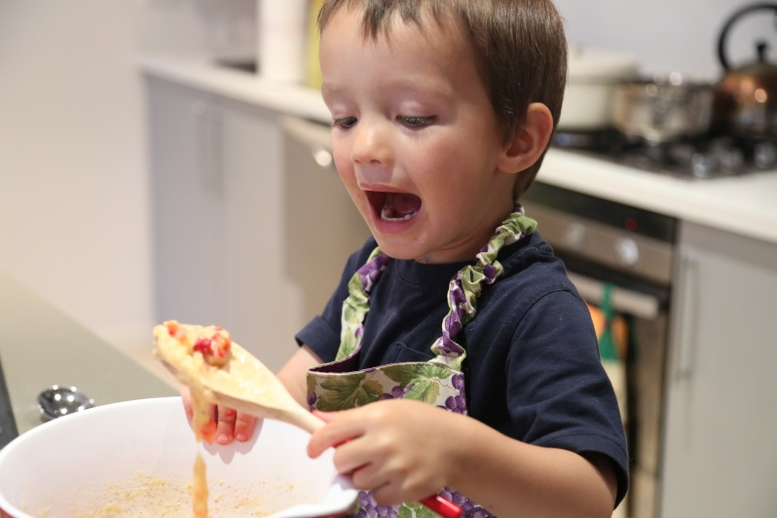
Montessori ideas (and ideals)
Spontaneous activity

Slide 10
Montessori ideas (and ideals)
Auto-education

Slide 11
Montessori ideas (and ideals)
Absorbent mind

Slide 12
Montessori ideas (and ideals)
Planes of development

Slide 14
Montessori ideas (and ideals)
Prepared environment
“Now the adult himself is part of the child's environment; the adult must adjust himself to the child's needs if he is not to be a hindrance to him and if he is not to substitute himself for the child in the activities essential to growth and development."
The Secret of Childhood (1936)

Slide 15
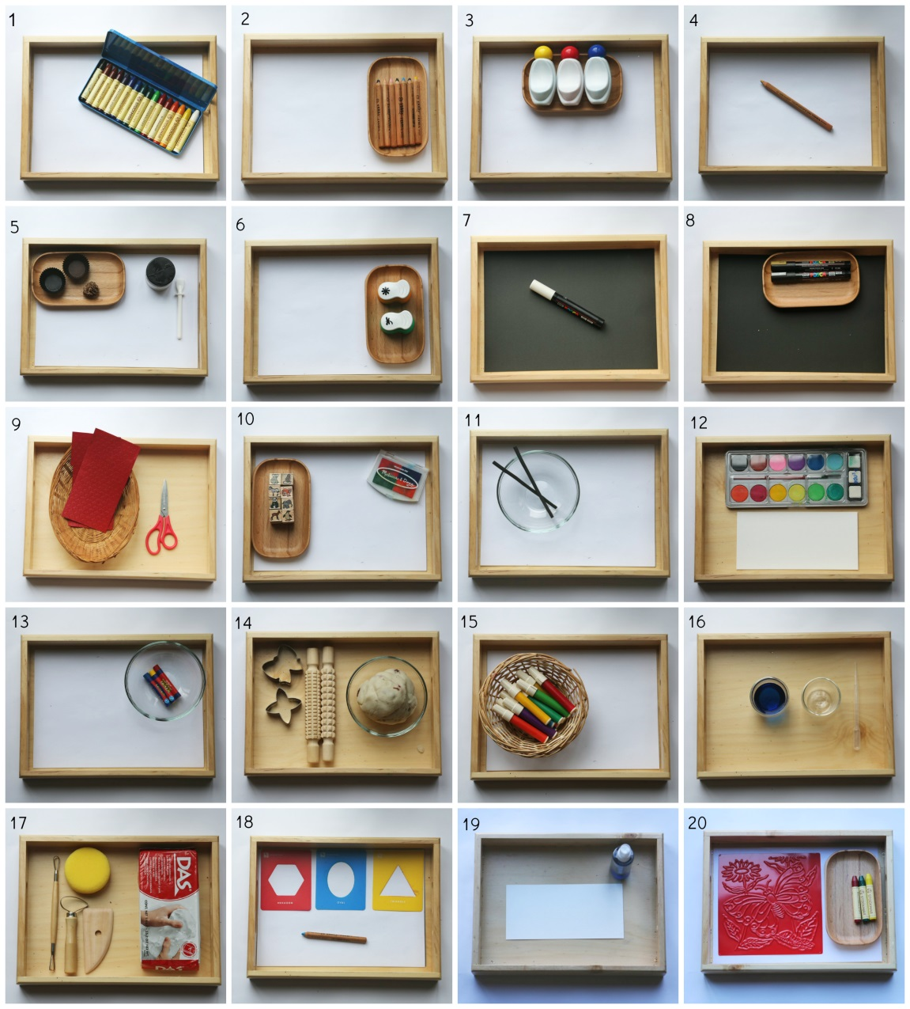
Montessori ideas (and ideals)
Three-period
lesson

Slide 16
Montessori ideas (and ideals)

Slide 17
Learning together in the company of children

Slide 18
Learning together in the company of children
"She must acquire a moral alertness which has not hitherto been demanded by any other system, and this is revealed in her tranquility, patience, charity, and humility. Not words, but virtues, are her main qualifications.”
The Discovery of the Child (1909)

Slide 19
Learning together in the company of children
www.facebook.com/DallasMontessoriTeacherEducationProgram101/
www.facebook.com/photo.php?fbid=10210733767251235&set=a.10210733766931227.1073741827.1561107054&type=3&theater
www.facebook.com/myra.arnold.96/media_set?set=a.10210733766931227.1073741827.1561107054&type=3&pnref=story
https://montessorilifeasweknowit.files.wordpress.com/2014/11/20141116_art-trays-collage-high-quality.jpg
https://photos.google.com/photo/AF1QipN0uwymXPtR68JgW4QQEj2hXihzazIxshEQQby1

Slide 20
Learning together in the company of children
Josh Thompson, Ph.D.
JOSH.THOMPSON@TAMUC.EDU
@bILLYjOSHtEX
http://faculty.tamuc.edu/jthompson/Montessori

